Slide 1

Business Intelligence Essentials
By Team Rocket

Slide 2
Table of Contents
Introduction
Problem Statement
Research and Findings
BI Market Growth
Key BI Components
Popular BI Tools
Future role of BI
Opportunities
Challenges
Conclusion

Slide 3

Introduction to Business Intelligence
Overview
Business Intelligence
Business Intelligence (BI) is a technology-driven process that transforms raw data into meaningful insights, enabling organizations to make informed decisions.
BI encompasses data analytics, reporting, and visualization tools that help identify trends, track performance, and optimize operations.
Effective BI helps organizations increase efficiency, enhance customer experiences, and improve financial performance by leveraging data-driven strategies.

Slide 4
Problem Statement
Data Overload: Organizations collect large amounts of data but struggle to process and interpret it effectively.
Slow Decision-Making: Traditional reporting methods take time and do not provide real-time insights for quick decision-making.
Lack of Integration: Data is often scattered across multiple sources, making it difficult to consolidate and analyze efficiently.
Competitive Pressure: Companies without BI tools risk falling behind as competitors leverage data for strategic advantages.

Slide 5


Current BI Market Growth
Research and Findings
Rapid Expansion of BI Industry
The BI industry is rapidly expanding, with global adoption expected to grow significantly in the coming years due to increased demand for data-driven decision-making.
Case Studies: Coca-Cola and Netflix
Coca-Cola: With 35 million Twitter followers and a whopping 105 million Facebook fans, Coca-Cola benefits from its social media data. Using AI-powered image-recognition technology, the company can tell when photographs of its drinks post online. This data, paired with the power of BI, gives the company important insights into who is drinking their beverages, where they are and why they mention the brand online. The information helps serve consumers more targeted advertising, which is four times more likely than a general ad to result in a click.

Slide 6

Netflix:
The online entertainment company’s 148 million subscribers give it a massive BI advantage.
How does Netflix use business intelligence?
Netflix uses data in multiple ways. One example is how the company formulates and validates original programming ideas based on previously viewed programs. Netflix also uses business intelligence to get people to engage with its content. The service is so good at targeted content promotion that its recommendation system drives over 80% of streamed content.

Slide 7
Key Components of BI
Components
Data Warehousing
Data Mining
A centralized storage system that consolidates data from various sources, enabling efficient analysis and reporting.
The process of discovering patterns and extracting valuable information from large datasets to inform business decisions.
Reporting & Visualization
Predictive Analytics
Dashboards and visual reports that present data in a clear and intuitive format for executives and stakeholders.
Utilizes AI and machine learning to anticipate future trends, helping organizations make proactive decisions.

Slide 8

Popular BI Tools
Key BI Components
Microsoft Power BI
Tableau
A leading BI tool that offers robust data visualization and business analytics capabilities, enabling users to create interactive reports and dashboards.
Renowned for its user-friendly interface and powerful visual analytics, Tableau helps users explore and understand data through interactive dashboards.
SAP BusinessObjects
QlikView
Google Data Studio
An enterprise-level BI suite that provides comprehensive reporting, analysis, and visualization tools, suitable for large organizations.
Offers powerful data visualization and self-service business intelligence, allowing users to create personalized dashboards and explore data freely.
A free tool that transforms data into informative, easy-to-read, and shareable reports and dashboards with real-time collaboration features.

Slide 9
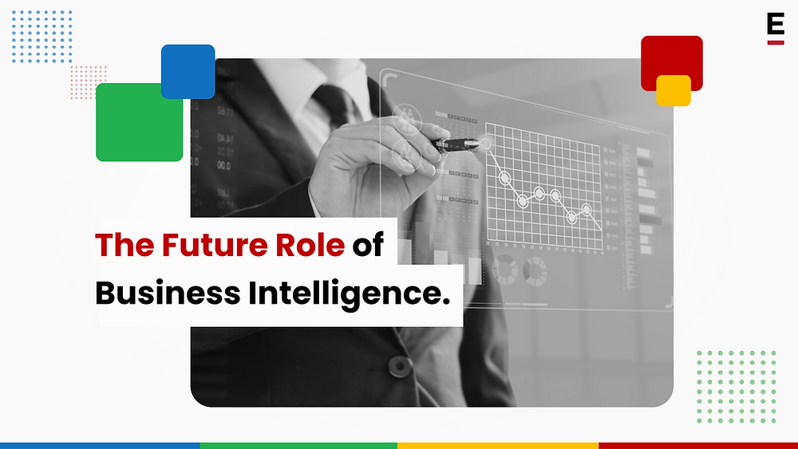
Future role of BI
The future of Business Intelligence (BI) will be more strategic, predictive, and accessible. It will evolve from reporting insights to driving business strategy, leveraging advanced analytics and machine learning for forecasting. Self-service BI tools will make data analysis easier, while integration with systems like CRM and ERP will provide a holistic view of performance. BI will help businesses make informed decisions, drive innovation, and stay competitive.

Slide 10
Opportunities
Competitive Advantage
Operational Efficiency
Companies that leverage BI can stay ahead of competitors by identifying emerging trends and optimizing business strategies.
BI enables automation of repetitive tasks, reducing costs and improving productivity.
Customer Insights
AI and Automation
Skill Development
Businesses can analyze customer preferences, predict buying behavior, and personalize marketing efforts to improve customer satisfaction.
The integration of AI and machine learning into BI tools enhances decision-making by providing faster and more accurate insights.
Working with BI tools and techniques can enhance analytical and problem-solving skills

Slide 11

Challenges in Implementing BI
Challenges
Data Integration
Scalability
Integrating data from multiple sources can be complex due to differing formats and structures, hindering effective analysis.
BI solutions must accommodate growing data volumes and user demands as businesses expand, posing scalability challenges.
Data Quality
User Adoption
Inaccurate or inconsistent data can lead to unreliable insights, impacting decision-making and operational efficiency.
Low adoption rates can occur if users are unfamiliar with BI tools or lack skills to interpret data effectively.
Data Security
Cost
Protecting sensitive information while ensuring compliance with regulations adds complexity to BI implementations.
The financial investment required for infrastructure, software, and personnel can be significant, affecting BI deployment.

Slide 12

Conclusion: BI's Impact on Business
Conclusion
Business Intelligence (BI) plays a crucial role in enhancing organizational efficiency, enabling faster and more informed decision-making, and fostering innovation. By transforming raw data into actionable insights, BI empowers companies to optimize operations, identify market trends, and improve customer experiences. As businesses increasingly rely on data-driven strategies, BI emerges as a vital tool for driving success in a competitive landscape.

Slide 13
Thank you.

